Slide 1
Sprint 3 Presentation
Buddis

Slide 2
Business Requirements Document
Initially our BRD was created with our old app idea
We decided to scrap the idea because most of us didn’t like the app idea
We completely refactored our BRD with StudiBuddi
Notes:
luke

Slide 3
User platforms
We originally planned this application to be a website but due to our primary market research, we decided to move this to a mobile app
This would be more convenient for students since phones are much more convenient for them to use.
We also do not have to learn a new language to program the application
Notes:
luke

Slide 4
Strengths
StudiBuddi allows students who are too shy to ask help from their professor or the tutoring center
When students are meeting in person, they are more likely to have a better experience when they collaborate with each other
Team is experienced in using databases, java, and one person that is experienced in Android Studio
Our team is part of the target demographic and are familiar with what students struggle with
Notes:
Tymee

Slide 5
Weaknesses
Four out of five students never used Android Studio before starting this project
We have never made an application of this scale requiring multiple users
Our team does not have experience with machine learning
We may be the initial target demographic, but it may become difficult to expand the application to support different departments
Notes:
Tymee

Slide 6
Opportunities
StudiBuddi could be expanded to other departments at CSULB. Currently using CECS department as a small sample size.
We could also expand this to other universities
Machine learning could be applied when a set of students are studying with each other
This application works best with a narrow demographic such as students
Notes:
Tymee

Slide 7
Threats
Quizlet, students use this study for their classes and it is effective for helping students with topics they are struggling with
StudyBlue allows users to share their flashcards with other users
StudiBuddi could have problems with safety when suggesting locations. We need to ensure that the application has options that are in public and safe spaces
Notes:
Tymee

Slide 8
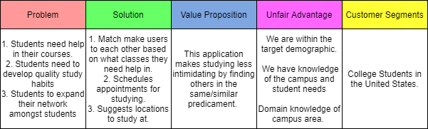
Strategy
Notes:
Oscar

Slide 9
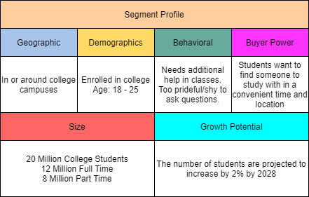
Market Segments
Notes:
Oscar

Slide 10
Product Requirements Document
No Updates were made in the PRD
Notes:
Oscar

Slide 11
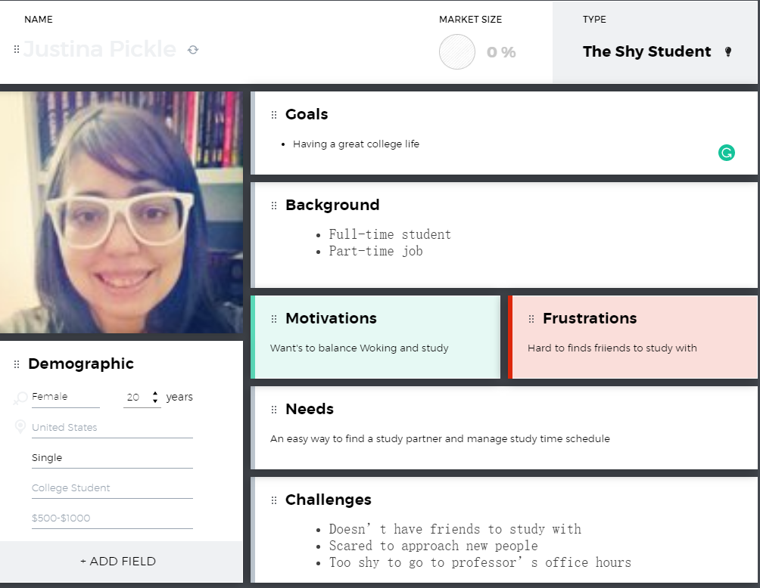
User Personas
The shy student
The new student
The international student
Notes:
luke

Slide 12
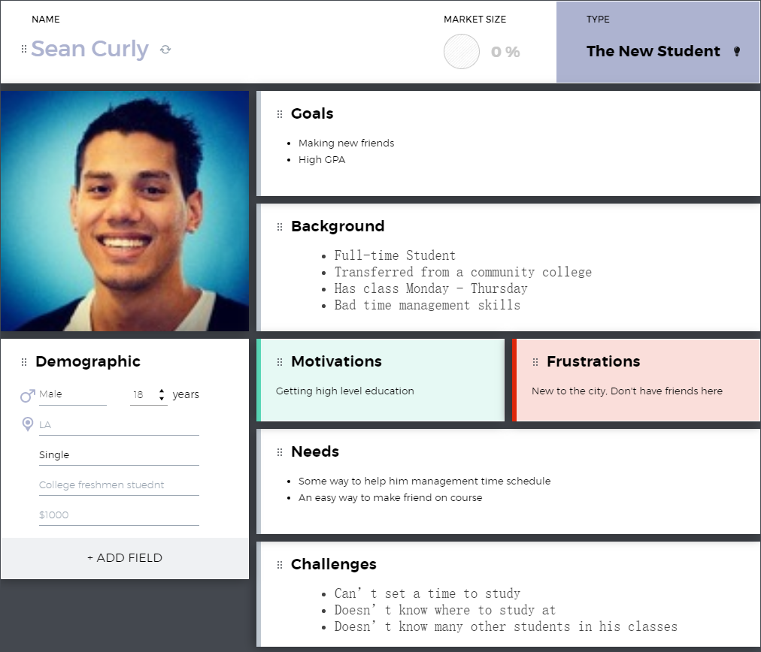
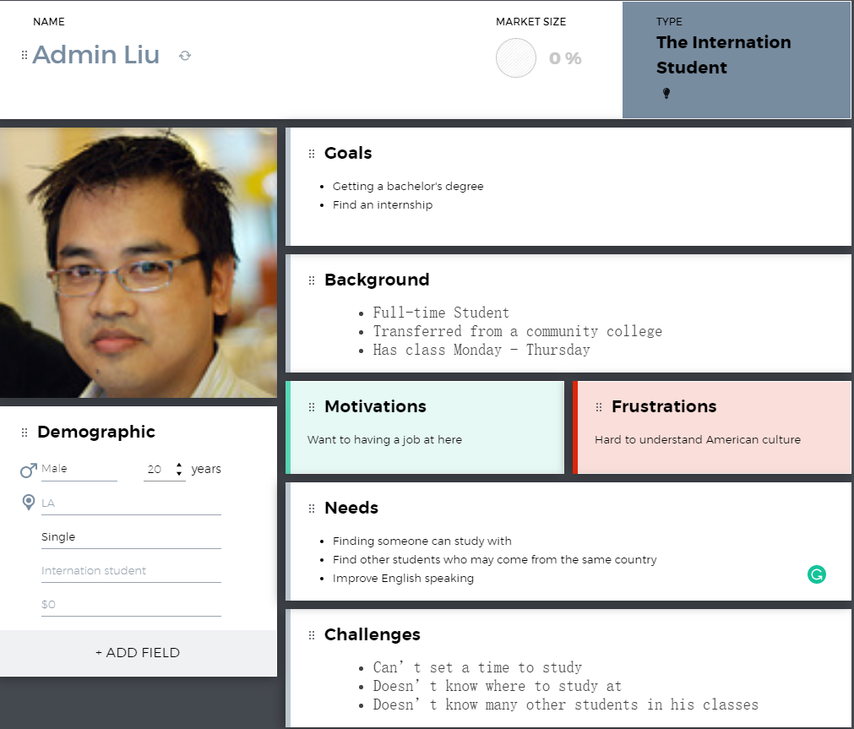
User Personas
Notes:
Mention or add the third persona
luke

Slide 13
User stories
We have a total of 50 user stories that we had laid out for the app
Some user stories included
Creating General posts
Creating a studi session
Inviting other users to the studi session
Request to join a studi session
Notes:
Tymee

Slide 14
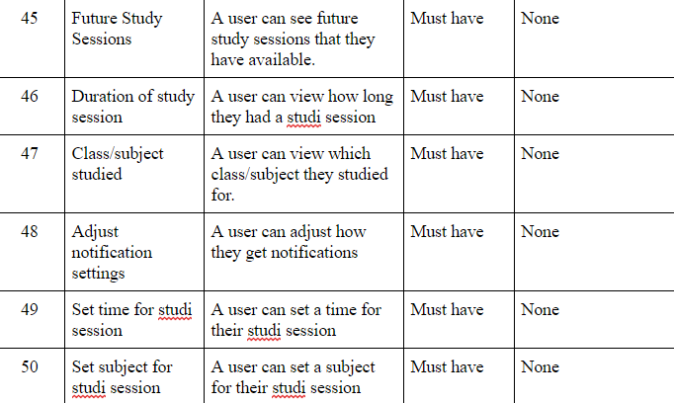
User Stories Continued
Notes:
Tymee

Slide 15
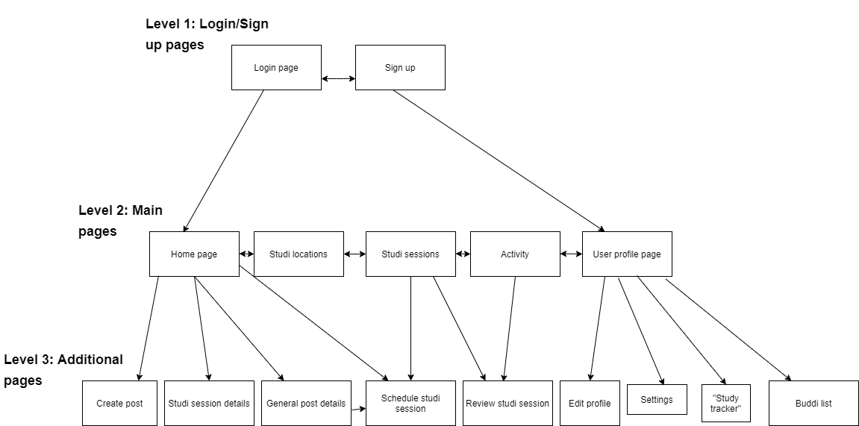
Server Sitemap
Notes:
tanner

Slide 16
Architectural Design Document
More tradeoff analysis
We added many components that were missing to the ADD
Added Major Architecture Patterns
Notes:
Tanner

Slide 17
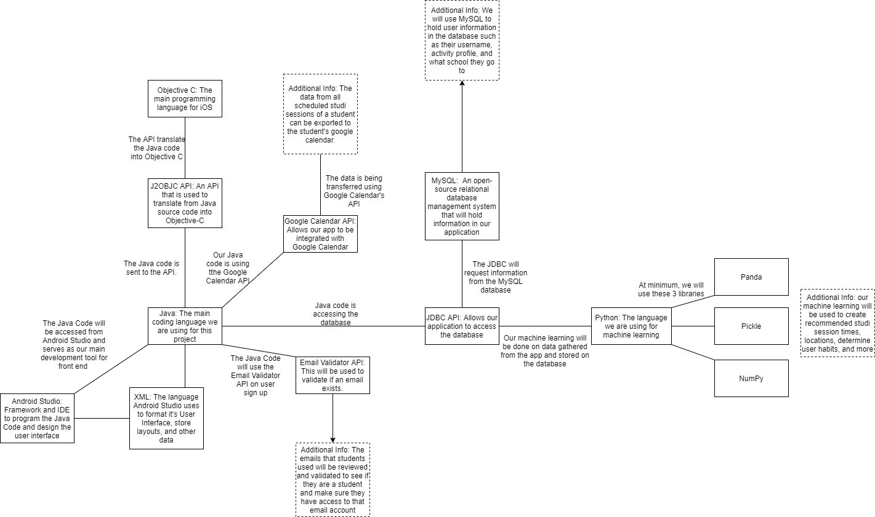
Interface Diagram
Notes:
tanner

Slide 18
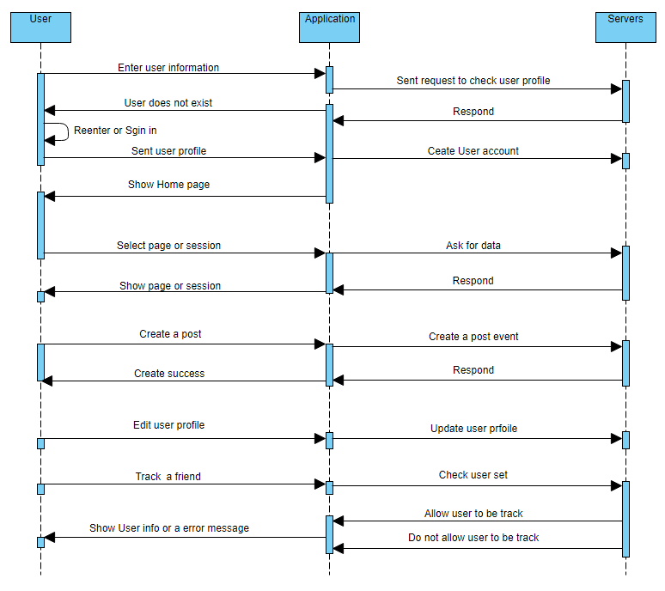
Sequence Diagram
Notes:
luke

Slide 19
Event-Driven Architecture
This type of architecture is best with applications with user interfaces
Our application will constantly be waiting for user input for the application to do anything.
Advantages
Add new features easily
Easily scalable
Disadvantages
High coupling could make it difficult to add new features
Error handling would become a nightmare
Notes:
Tymee

Slide 20
Client-Server Architecture
The client-server architecture is used for creating online applications with one server and multiple clients
Our application will be an online application that we will require a server
We need this for features such as creating posts, commenting on posts, and creating studi sessions
Notes:
Tymee

Slide 21
User’s Stories Accomplished
Story points delivered to users are:
Signing up (5 points)
Logging in (5 points)
Notes:
Oscar

Slide 22

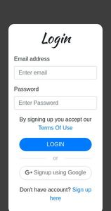


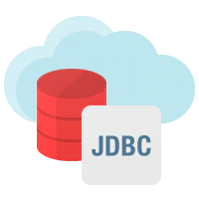
Code Core Components
INSERT INTO
Stored in MySQL database hosted in Amazon RDS
Main coding language for server
User signs up
Notes:
tanner

Slide 23
Code Release V1
We were happy with the code we released last time
Learned and implemented new technologies
Coded working login page
Communication between front-end and back-end
Notes:
tanner

Slide 24
Code Release V2
Improved efficiency of login/signup
Cleaned up user entered data sent to DB
Implemented single-activity android architecture as recommended by Google
Fast switching between navigation screens (home, profile, etc.)
Fast memory management and lower memory requirements while app is running
Deployed on Google Play Store!
Notes:
hunter

Slide 25
Future Release Features
Continue to improve the UI
Intuitive and good looking
Creation of posts and studi sessions
Browse locations to studi on campus
Limit user data by location
Customize profile
Push notifications
Enhanced filter options
Persistent login
Notes:
hunter

Slide 26
Kano Model
Must Have: 65%
Performance: 25%
Wow Factor: 10%
Notes:
hunter

Slide 27
Machine Learning Plans
Per our design of the program, we need our model to rank the weight of each session and give the user a time schedule to work with.
Find a model that can help with ranking different course
A way to match different course with a different time schedule
Find a place for the different user to working together
Notes:
Luke

Slide 28
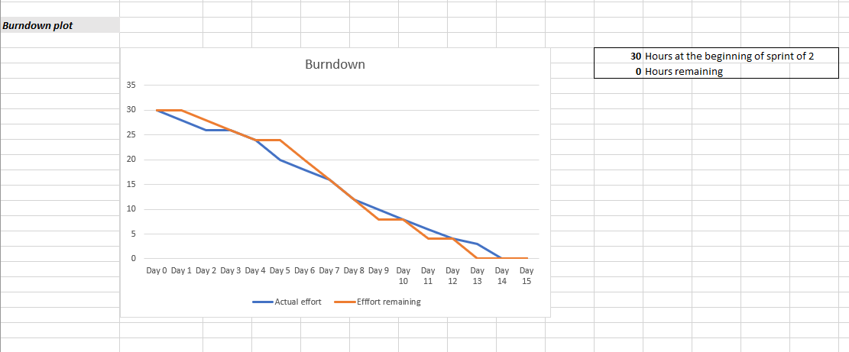
Burndown Curve
Notes:
tanner

Slide 29
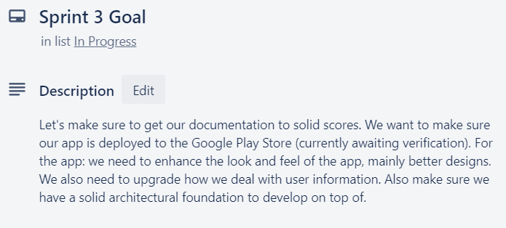
Sprint #3 Goal
Notes:
hunter

Slide 30
Sprint #3 Retrospective
Discussed future plans and how we will continue in fall semester
Our online workflow is working okay, we will need to coordinate more frequently once more complex development continues
80% of tasks we planned for the sprint were completed
Notes:
hunter

Slide 31
Code Review

